Slide 1
Advancing the whole child concept in light of the global Black Lives Matter movement
Adding “political” to the psychological, social-emotional, cognitive/academic, and physical needs of the whole African American child
3rd Annual Whole Child Summit
Equity and Social Emotional Learning:
Fostering a Safe Environment for All
Indiana School Mental Health Initiative
Indiana Department of Education
February 24, 2021 Indianapolis, Indiana
John Harris Loflin © 2021 Black & Latino Policy Institute

Slide 3
Intersectionality

Slide 5
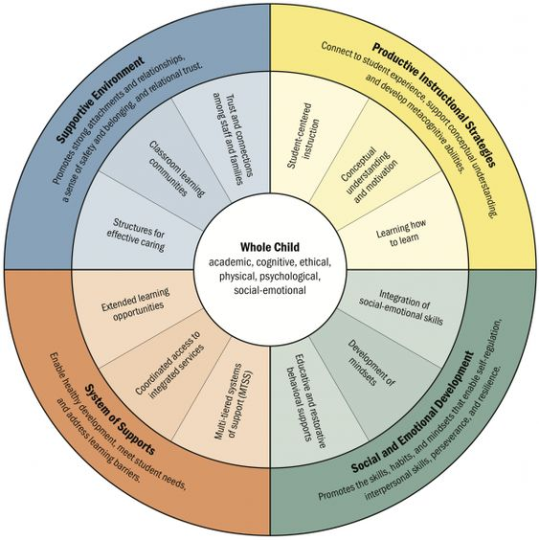
Four ways school can support the whole child
Academic Cognitive
Ethical Physical
Psychological Social-Emotional
https://greatergood.berkeley.edu/article/item/four_ways_schools_can_support_the_whole_child

Slide 6
Productive Instructional Strategies
--connect to student experience
--support conceptual understanding
--develop meta-cognition abilities
Social and Emotional Development
--promotes the skills habit and mindsets that
--enable self-regulation
--interpersonal skills
--perseverance and resilience
Supportive Environment
--promotes strong attachment and relationships
--a sense of safety and belonging
--relational trust
System of Supports
--enable healthy development
--meet student needs
--address learning barriers

Slide 7
The key lessons on the science of learning and development from Educating the Whole Child Report
--Development is malleable. --Variability in human development is the norm, not the exception.
--Human relationships are the essential ingredient that catalyzes healthy development and learning. --Adversity affects learning—and the way schools respond matters. --Learning is social and emotional, as well as academic. --Children actively construct knowledge based on their experiences, relationships, and social contexts.
-- Educating the Whole Child Report 2018 www.learningpolicyinstitute.org

Slide 8
Political
This is not about education at all. It’s about power -- James Baldwin
Political relates to the public affairs of a community, city, or country
Politics (from Greek: Πολιτικά, politiká, 'affairs of the cities') is the set of activities that are associated with making decisions in groups, or other forms of power relations between individuals, such as the distribution of resources or status - https://www.thefreedictionary.com/political
Public schools are a child’s introduction to politics, to life in the polis
Politics is the art of preventing people from taking part in affairs that properly concern them -- Paul Valery
Politics is about power--who has it and who doesn’t, and why
Politics is about who gets good sidewalks, necessary clinics, beautiful parks, handy grocery stores and banks, police who don’t beat you up…

Slide 9
MLK and cui bono?
“The function of education is to teach one to think intensively and to think critically. -- MLK
In other words, the function of education is to teach one to think intensively and to think politically.
Cui bono? Who benefits when African American students are not exposed to critical thinking?

Slide 10
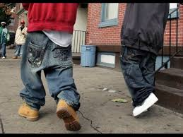
Black hair and clothing styles are fashion statements, but they are also political statements

Slide 11
What are public schools for?
True democracy does not use education to move the worker-citizen from unskilled to skilled. Instead, democracy relies on education to position every citizen to govern.
This project of democratic education can be carried out only by educators with the critical commitment to act on behalf of freedom and social justice that serve as a model for their students to discover their own personal power, social transformative potential, and spirit of hope.
-- from the ideas of Antonia Darner (1997)

Slide 12
Dead Prez
“They schools ain’t teachin’ us what we need to know to survive. They schools don’t educate. All they teach the people is lies…They ain’t teachin’ us nothin’ but how to be slaves and hard workers for white people, to build they shit, make they businesses successful while they exploitin’ us…
They ain’t teachin’ us nothin’ related to solvin’ our own problems…Ain’t teachin’ us how to get crack out the ghetto. They ain’t teachin’ us how to stop the police from murdering us and brutalizing us. They ain’t teachin’ us how to get our rent paid…They ain’t teachin’ our families how to interact better with each other…They just teachin’ us how to build they shit up…” -- Dead Prez, 2000, track 3

Slide 13
Why Black and Latino Males Don’t Go into Teaching and What to Do about It
“If, as a result, many of our students of color perceive school as a necessary gauntlet to get through, why would they ever return, much less on purpose? I’ve asked around and, anecdotally, many young people of color see school as a thing one escapes. Why would any black kid, even the highest achieving, go into education? To recruit more teachers of color, improve students’ experiences.”
-- Matthew R. Kay, “Where are all the Black teachers?” Educational Leadership, October 2019, p. 88

Slide 14
“[Urban] students quickly receive the message that they can only be smart when they are not who they are. You learn to suppress who you are, but more dangerous than suppression, you learn to devalue the things that make you you.
In urban public schools if you want to succeed academically, you have to disavow essential parts of yourself--the loud parts, the parts inclined to challenge authority.”
-- Prof. Chris Emdin
I failed your class ‘cause I ain’t with your reasoning. You’re trying to make me you.”
-- Boogie Down Productions, “You must learn” 1989 https://www.jiosaavn.com/lyrics/you-must-learn-live-from-caucus-mountain-remix-lyrics/AlEsYCRfRWM

Slide 15
Cultural competency is not enough: Advancing culturally relevant teaching as politically relevant teaching
The purpose of this presentation is to examine culturally relevant teaching as a political pedagogy and a new manifestation of what was considered "good" teaching in many Black communities served by segregated schools. Opened in 1927, Attucks is an example.
An examination of accounts of these schools that were valued by students and families reveals that the "good" of these institutions hinged not simply on the cultural similarities between teachers and students, but more importantly on the "political clarity" of the teachers.
That is, these educators recognized the existence of oppression in their students' lives and sought to use their personal, professional, and social power to encourage children to understand and undermine their subordination.
Thus, it was not the fact they shared the students’ culture, but that they shared their politics. Teachers used their knowledge of society's inequities and their influence to empower their marginalized students.
By recognizing the political and historical dimensions of culturally relevant teaching, its applications are broadened, expanding to issues of racism and social injustice that are relevant to all Americans
http://vorcreatex.com/wp-content/uploads/2012/11/Cultural-competency-is-not-enough-Advancing-to-politically-relevant-teaching.pdf John Harris Loflin, 2012

Slide 16
Our challenge!
It was not the fact the all-Black teacher corps in a segregated Attucks HS shared their students’ culture, but that they shared their politics.
It was all about the "political clarity" of the Attucks teachers
It was the ability of Attucks teachers to recognize the existence of oppression in their students' lives and do something about it
How can we teachers use our personal, professional, and social power to encourage Black children to understand and undermine their subordination?
2. How can we teachers use our knowledge of society's inequities and our influence to empower marginalized students?

Slide 17
What are we going to do?

Slide 18
Recognize the global human rights of children and youth
Children’s rights are human rights
“All children are entitled to protection from abuse; provision of education, health care and an adequate standard of living; having their views heard, and; children vulnerable to discrimination are entitled to specific protections.”
-- Children’s Rights are Human Rights, Canada's Campaign 2000 to End Child Poverty
Children and youth of Indianapolis have global human rights
--Children/youth must know they have global human rights
--Adults must know children/youth have these rights and validate them
--Children/youth must know that adults know they have human rights and so expect adult to recognize these rights
Create an Indianapolis version of the global
human rights of children and youth
Make a pocket version students can carry around

Slide 19
Universality
“Act only on the maxim whereby thou can at the same time will that it should become a universal law.
-- Immanuel Kant’s Categorical Imperative

Slide 20
Child-centered vs. Community-centered Learning
I think, therefore I am
European perspective: The Cartesian method “cogito ergo sum”
In an attempt to understand his existence, Descartes (1596-1650) arrives at a single principle: thought exists. Since thought can’t be separated from the person, thus, the person exists: I think, therefore I am. Decartes’ first person perspective becomes the essence of the individualism of European thought and culture.
Thus, learning concerns self discovery, self-development and fulfillment, self-reliance, and personal autonomy.
I am because we are
African perspective: The Ubuntu principle “umuntu ngumuntu ngabantu”
Ubuntu comes from a Zulu proverb, “A human being only becomes a human being through other human beings.” In Zulu culture, the manner of greeting is: “I see you.” The return greeting is: “Here I am.”
Communal constructivism: We exist because we are seen, because the people around us respect and acknowledge us as a person
“Learning should always be in connection with the community, because nothing of what we learn is of value unless it is of significance to the perseverance and well-being of the community.
“Communal constructivism” Dick de Groot, 2006

Slide 21
The “Super 6” Urban Education Fundamentals
Keynote Address Part I
John Harris Loflin
Black & Latino Policy Institute
Indianapolis, Indiana USA
South African
International Conference on Education
African Academic Research Forum
Pretoria, South Africa
September 23, 2014

Slide 22
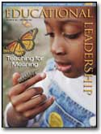
B&LPI ‘s “Super 6” Urban Education Fundamentals
We are each born curious and motivated to learn

Slide 23
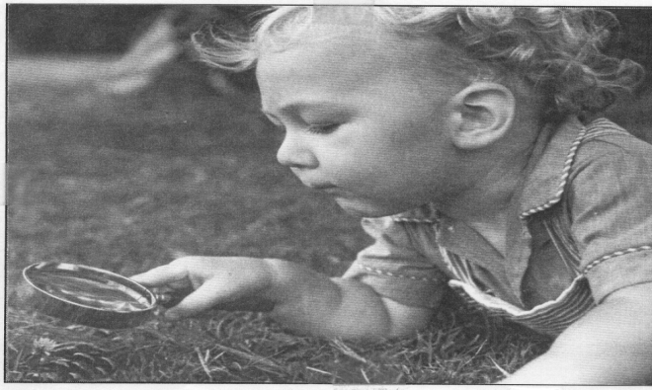
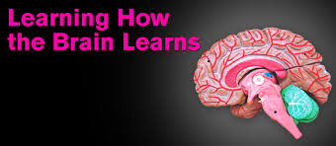
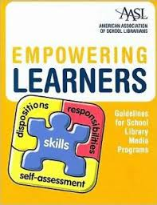
We are Homo curaos
There is no such student as a “reluctant learner”
Our brain does not have
to be taught how to learn
A Learner’s Bill of Rights

Slide 24
A Learner’s Bill of Rights
LBR respects and maintains a student’s natural curiosity and motivation to learn with this affirmation:
“I am a human being. I have an innate ability to learn. I was born full of wonder, curiosity, and motivated to learn. I view my self and I expect others to view me as capable of learning and showing what I know and can do.”

Slide 25
LBR
1. I have a right to a safe learning environment.
2. I have a right to accept myself as I am and to be accepted as I am.
3. I have a right to be respected and to define success in my own terms.
4. I have a right to learn at my own speed and in my own way.
5. I have a right to ask whatever questions I have, to say I don't understand, and I have a
right not to understand.
6. I have a right to be different, to have my own culture, opinions, and values.
7. I have a right to think for myself, question authority and challenge facts.
8. I have a right to express my own views without ridicule.
9. I have a right to need extra help and to ask for it.
10. I have a right to be treated fairly and to understand the grading process.
11. I have a right to evaluate my teachers and how they teach.
12. I have a right not to base my self-worth solely on my academic performance.
I have a right to my own expectations and limitations, to change my mind, to give up,
to succeed, to fail.
I have a right to make mistakes, to risk, guess, to have more than one way and one
chance to show what I have learned.
I have a right to be a part of the decision making process that concerns my education,
classroom, and school—with my involvement determined progressively by my age and grade.

Slide 26
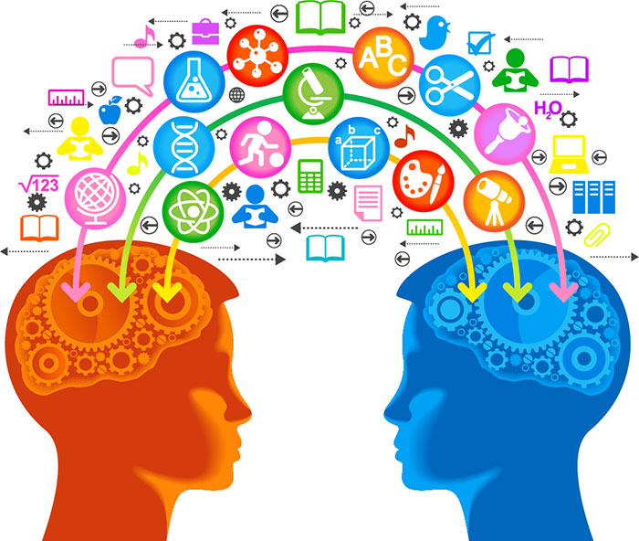
Our brain is a social brain
Our brain connects new information to what it already knows
Learning does not come from teaching; learning comes from thinking

Slide 27
Frame of Reference*
Learning does not come from teaching; learning come from thinking.
The brain connects new information to what it already knows so a teacher can’t teach you anything you don’t have some idea about in the first place
Teachers are trained to think they “teach” students something. This is the “banking “ concept: Students’ heads are empty and teachers make deposits which students withdraw during tests.
But this is used to hide the fact teachers are colonizing—confusing education with assimilation
“Education is indoctrination for whites, subjugation for Blacks .” – James Baldwin
Schools/teachers use the mainstream’s frame of reference (cultural capital) and not the student’s frame (cultural capital) to teach them
If a student does not have that frame or can’t understand that frame, they can do poorly White middle-class students are raised in that frame
Students come to school with their own frame (Funds of Knowledge), but many times it’s not respected and used
*Dr. Yvette Jackson Pedagogy of Confidence

Slide 28
Cultural Values in Learning and Education - Trumbull, Greenfield & Quiroz, 2003
 | Characteristics of Dominant American Culture | Characteristics of Non-dominant American Culture
1) Social history | Individualism--emphasizes independence | Collectivism--emphasizes inter-dependence
2 )Worldview | Western—Anglo-Saxon Northern European | Non-western
3) Main orientation to | Objects | People
4) Relationships | Egalitarian | Hierarchical--respect for tradition & authority
5) Child-development | Primarily an individual matter (ala Piaget)—it happens in stages & is the same for everyone | Primarily group matter--takes different paths depending on the goals of child rearing in a particular community
6) Parents define & place value on early cognitive development in terms of child’s: | Knowledge of the physical world (defining/describing objects) & linguistic communication skills | Development of social intelligence—interpersonal relationships, responsibility for others, & cooperation
7) Conceptualizations of intelligence | An intelligent child is one who is aggressive and competitive | An intelligent child may be one who knows how to complete chores for family
8) Parental communications Emphasize | Distal modes of communication through linguistic means | Proximal modes of communication such as touching and holding
9) School’s emphasis on developing each child's potential | Views this as normal & healthy for development | May perceive this as encouraging undesirable selfishness
10) Classroom learning style | Prefer to work alone—in some cases, asking for help is a sign of weakness | Prefer to work in groups & to "seek out class-mates & teachers for discussion, clarification, & help

Slide 29
Cultural Values in Learning and Education
Unfortunately, the current educational reform movement has moved to a 'one-size-fits-all' model of teaching and testing; facts show this approach is doomed to failure.
Children of voluntary minority groups (groups other than the descendents of enslaved Africans) cannot succeed if what is most valued in school--individual achievement--is considered selfish egotism at home.
Equally vital, is the “one-size-fits-all” model loses sight of how alternative in-puts can enrich the dominant culture. For example, the [American] ideal of the self-fulfilled individual can, at the extreme, lead to wide-spread isolation, alienation, and violence.
Hence, an emphasis on family responsibility and solidarity, so intrinsic to collectivistic cultures, can impart a moderating influence on our society.
-- Trumbull, Greenfield, & Quiroz, “Cultural Values in Learning and Education”

Slide 30
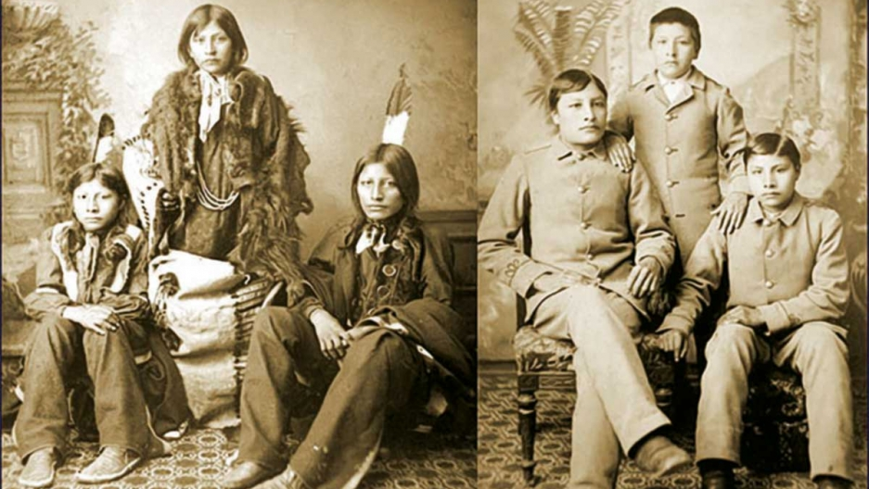
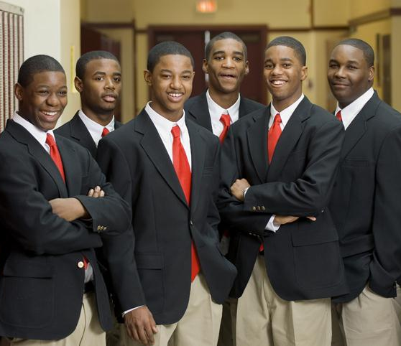
Schooling the World --The White Man's Last Burden https://www.youtube.com/watch?v=ENlvc19eXnM&t=7s
Kill the Indian, save the man
Kill the homeboy, save the man?

Slide 31
Neo-indigenous students
After doing consulting work with a Wyoming tribe, high school science teacher Dr. Emdin saw a connection with the Carlisle (Pa.) Indian boarding school (1879-1918) where Native hair styles, dress, language, music, and were forbidden and his east coast urban students and their schooling scenario.
He now refers to his students as “neo-indigenous” youth.

Slide 32
Back to Frame of Reference
The Algebra Project teachers take students on a bus ride as frame of reference
Interests Inventories

Slide 33
x
MUSIC
R & B
__Ashanti
__Erykah
Badu
__Beyonce
__R. Kelly
__Monica
__M. J. Blige
__Aaliyah
Sports teams
Magazines
School Subjects
__Math
__Art
Sports
__Football
__Basketball
__Hockey
__Wrestling
__Boxing
__Tennis
Dances
__Harlem Shake
__Crip Walk
__Heel Toe
__Chicken Head
DJ’s
__DJ World
__DJ Paul
__DJ Quick
__DJ Gus
T.V. Shows
__Clueless
__Eye Spy
__My wife &
kids
Other
__Fashion &
Clothes
__Cars
__Dogs
Name___________________________
GAMES
Cards
__Spades/Hearts
__Rummy
__UNO
__Solitaire
__Speed
__Euchre
__Tonk
Board Games
__Chess
__Checkers
__Chinese
Checkers
__Backgammon

Slide 34
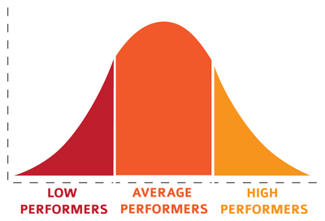
2. Abandon “one-size-fits-all” normalcy and the bell curve mentality
Create of a fluid educational system where difference is a “taken for granted” attribute of every child who enters a public school classroom
Create a Strength-Based Learning Plan for each student

Slide 35
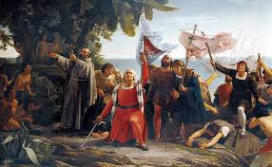
Normalcy 1492 The social construct of the “West” and the “other”
Europe “discovers” the “other” or the “differon”
Disability is a political concept; there is no disability without normalcy
“The problem’s not the student with learning disabilities; it’s the way normalcy is constructed to create the ‘problem’ of the learning disabled child.”
-- L. Davis, “Constructing Normalcy”
“I’m not deaf, you can’t sign. You have a signing disability. I’m normal.” -- L. Davis, “Constructing Normalcy”

Slide 36
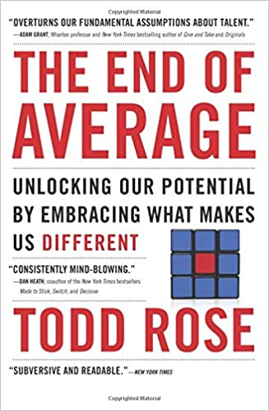
Myth of the normal child

Slide 37
Strength-based Learning Plan Discrediting the Myth of the Normal Child Embracing the “differon”
Special Ed students get Individualized Education Plan (IEP) based on what they can’t do according to normalcy.
A Strength-based Learning Plan spends just as much time developing a student’s uniqueness, passions/interests--helping students to self-actualize--as trying to standardize them.

Slide 38
Incorporating the Voices and Insights of Students with Disabilities: Let’s Consider Our Approach
Dr. Barbara Pazey encourages research around students with disabilities, getting their input into curriculum, and school and classroom climate.
“Incorporating the voices and insights of students with disabilities: Let’s consider our approach” International Journal of Student Voice, 8. 2021
https://ijsv.psu.edu/?article=incorporating-the-voices-and-insights-of-students-with-disabilities-lets-consider-our-approach

Slide 39
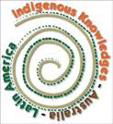
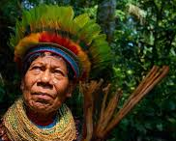
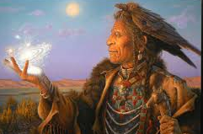
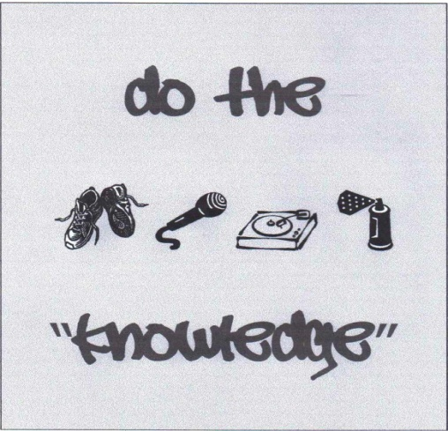
3. Western epistemologies are not the only epistemologies in the world
Non-linear epistemologies
Other epistemologies
~African~ ~Female~
“The inclusion of Stand Point
Indigenous Theory
epistemologies in ~Deaf~
higher education
in south Africa”
by Dr. Soul Shava
Decolonizing
Epistemologies
~Hip Hop~

Slide 40
Epistemology and an equitable educational system
Epistemology--the theory of knowledge: how we create knowledge and justify beliefs
Western epistemologies are dominant US public school
White middle-class norms vs. White middle-class epistemologies
An equitable educational system doesn’t measure student achievement on the basis of assimilation into white middle-class norms
The ability of a student to read, write, and do arithmetic at the highest levels is not what is being referred to as white middle-class norms.
It is much deeper…
It is the use, by our current educational system, of curriculum, pedagogy, and measurements of these skills centering on white middle-class epistemologies.
Most urban educators, administrators, and school boards assume without question the “superiority” of such white middle-class ways of knowing.
The path to acquiring those skills (K-12 public education) is associated with the belief that the “skills” will be applied in the service of the existing power structure (economic, social, and political)—reproducing inequity.
Duncan-Andrade & Morrell, Critical Pedagogy (2008)

Slide 41
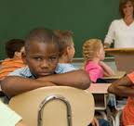
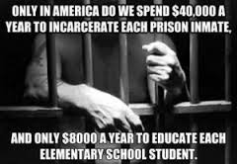
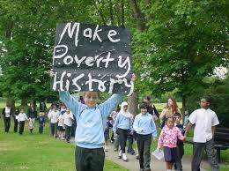
4. America’s urban schools are not failing; they are doing exactly what they were designed to do
Educating all children equally and effectively
has never been the mission of public education
We can’t call urban schools designed to fail, broken
The mission of urban school must be eradicating poverty and other social toxins not getting students “out of poverty”

Slide 42
We can’t call schools designed to fail broken The game is rigged. It’s inequity by design
Prof. Jeff Duncan-Andrade
“The game is rigged. It’s inequity by design”
https://www.youtube.com/watch?v=iccvmqHYp3Y

Slide 43
Public schools invert Black culture
Therapist: What is the purpose of school?
Student: To make us proper.
Therapist: To make who proper?
Student: To make Negroes proper.
From a conversation between an often suspended Special Ed 15 year old African American male student from IPS Arlington HS and Mike Sage his family therapist during spring semester of 2011
Public schools invert Black
--values breadth over depth
--individual competition over cooperation
--non-involvement over personal engagement
Schools are a source of self-doubt rather than self-development
Race acts inside the school to give groups of students systematically different experiences
Thus, education is seen as an imposition on Black people by white people
Hamovitch in “Alternative Education's Spoiled Image” J. Loflin (2000) pp. 43-45 http://vorcreatex.com/wp-content/uploads/2016/05/Alternative-Educations-Spoiled-Image-When-it-happened-how-it-happened-why-it-happened-and-what-to-do-about-it-.pdf

Slide 44
Too much school, too little education: Why school is the enemy for urban students…and what to do about it
For some Black children and youth, and their families, school is the “enemy”
That is, their school and teachers are seen as agents of social control
Knowing the difference between schooling and education instinctually, being resistant to schooling becomes an essential part of the identity of urban students regarding who they are
To the extent that these students are portrayed as those most likely to not have a high school diploma and end up in jail, schools need to regard the difference between schooling and education. Once appreciated, curriculum and pedagogy must adapt if each students is to be reached.
http://vorcreatex.com/wp-content/uploads/2016/03/Too-much-school-too-little-education-Why-school-is-the-enemy-for-urban-students-and-what-to-do-about-it.pdf

Slide 45
too much school, too little education
more and more home work
longer school years and days
less and less recess time
where the child just plays
high stakes tests
are now the norm
so’s students in a costume
they call a school uniform
classes acting up
giving teachers lots of lip
it looks like every kid
gets a detention slip
students in the hallways
not following the rules
they’re also cutting classes
dropping out of schools
fires in the bathroom
food fights during lunch
all this trouble really
should give us the hunch
there’s only one way
to understand this situation
too much school…
too little education
© 2017 dr. monday

Slide 46
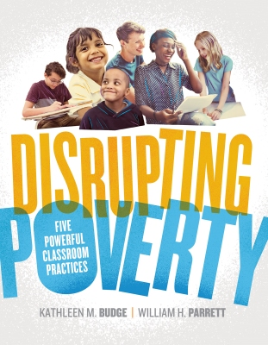
Moving beyond structural determinism: Urban schools as places to contest inequalities
What are urban schools for?
“The purpose of education for urban students is not to help them get out of poverty, but to get rid of poverty” -- Dr. Jeff Duncan-Andrade
We don’t want to “disrupt poverty,” we want to eradicate it.
“Poverty is the worst form of violence.” -- Gandhi
“Hungry people can’t be good at learning or producing anything, except perhaps violence.” -- Pearl Bailey
We need an anti-poverty curriculum

Slide 47
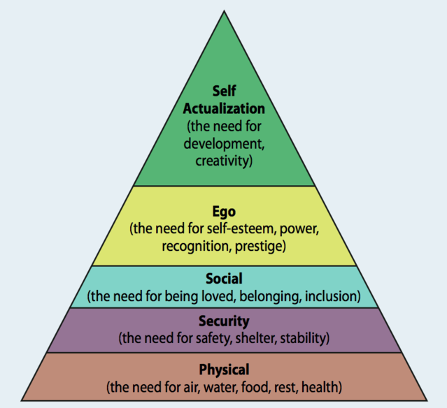
Maslow’s Hierarchy of Needs

Slide 48
How to make college a realistic option
Educators error by replicating the "college-going culture“ schooling ideology of the middle class
Ignores the material conditions of Black communities
These social toxins, such as poverty, are existential threats, thus are more pertinent to the lives of students which are far removed from the rhetoric of college
How to make college a realistic option
Black students deserve a system accomplishes 2 simultaneous goals
1. preparation to confront the conditions of social/economic inequity in daily lives
2. access to the academic literacies (reading, writing, math) that make college
attendance a realistic option
Double investment in urban communities
1. pedagogy/curricula lend immediate relevance to school in the lives of students
2. works to break the cycle of disinvestment of human capital in urban communities
--creates graduates who recognize their potential agency to:
--improve urban centers and their neighborhoods
--rather than seeing them as places to escape
Two definitions of success for rich/poor: Stay as a failure, get out as a success
For the wealthy: how close you live to where you grew up
For the poor: how far away you live from where you grew up

Slide 49
Pedagogy of Poverty
Put the “Going to college culture” in perspective
Emphasizing college allows us to avoid discussing poverty
Instead of pennants of various universities/colleges over doors put Housing, Employment, Gangs, Families…
Here students, around a generational theme, will study, analyze, develop solutions, and make public policy around the classroom themes.
Here students will read, write, and calculate using all the higher order thinking skills as they meet state standards.
These real-life connections to eliminating the existential threats due to the toxins they face daily, will help students understand why they are in school
As they prepare for career, college, and citizenship, students will make their lives and neighborhoods better. It’s a win-win situation.

Slide 50
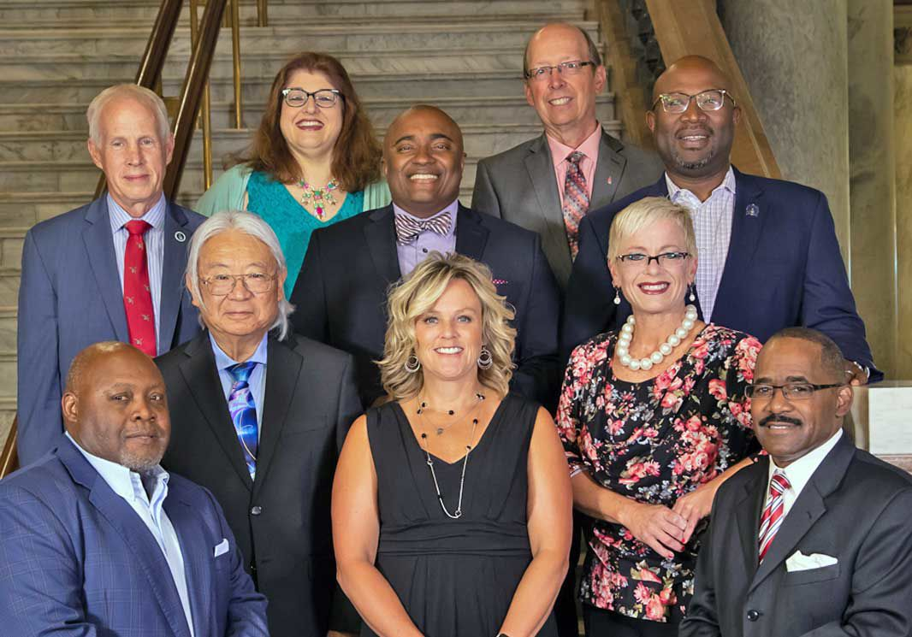
IDOE Ethnic Studies Standards
Here are 2 state standards out of the IDOE Ethnic Studies curriculum.
These standards are to be taught across the curriculum—
history, science, literature, math, music, etc
Standard 4.1: Students examine historical and contemporary economic, intellectual, social, cultural and political contributions to society by ethnic or racial group(s) or an individual within a group.
Standard 4.2: Students investigate how ethnic or racial group(s) and society address systematic oppressions through social movements, local, community, national, global
advocacy, and individual champions

Slide 51
Social Toxins
Interpersonal
--violence
--fear
--shame
--uncertainty
--nihilism
--loss of control
Structural
--poverty
--family dislocation
--lack of access to healthcare
--racism
--poor quality schools
http://vorcreatex.com/wp-content/uploads/2020/06/Urban-conditions-and-social-toxins-chart-From-radical-healing-to-wellness.pdf

Slide 52
Radical Healing Process Themes
Also see: “Toward a Psychological Framework of Radical Healing in Communities of Color” (2019) https://journals.sagepub.com/doi/full/10.1177/0011000019843506

Slide 53
Strength & Critical
Resistance Consciousness
Emotional & Cultural
Social Support Authenticity &
Self Knowledge
Interlocking Envisioning
Systems of Justice and
Oppression and Liberation
Hate
Radical Hope
https://news.stthomas.edu/tommie-experts-radical-times-call-for-radical-healing/

Slide 54
A holistic trauma-informed care in schools Advancing Social Medicine to Social Pedagogy
SOCIAL MEDICINE
Dr. H. Jack Geiger (1925-2020) used "social medicine" to treat patients. He use his expertise and moral authority (political clarity) not just to treat illness, but also to change the conditions that made people sick in the first place: poverty, hunger, discrimination, joblessness, and lack of education: https://www.nytimes.com/2020/12/28/health/h-jack-geiger-dead.html
Expanding trauma informed care policies: Healing symptoms while eliminating causes
http://vorcreatex.com/wp-content/uploads/2020/08/Expand-trauma-informed-care-policies-Healing-symptoms-while-eliminating-causes.pdf
SOCIAL PEDAGOGY
Is there a "Social Pedagogy" where teachers, along with "traumatized" student/s, can use their expertise and moral authority not just to respond to/treat the trauma for the sake of the child and other students, but also work with the student/s to change the conditions causing the trauma in the first place?
Empowering training in community organizing for vulnerable/affected students
http://vorcreatex.com/wp-content/uploads/2020/08/Community-Organizing-Advancing-the-Black-Agenda-for-Indianapolis-by-training-youth-how-to-community-organize.pdf

Slide 55
Dead Prez’s curriculum
--what we need to know to survive
--don’t educate us
--solvin’ our own problems
--how to get crack out the ghetto
--how to stop the police from murdering us and brutalizing us
--how to get our rent paid
--teachin’ our families how to interact better with each other

Slide 56
Anti-poverty curriculum
Urban school transformation: A comprehensive vision
http://vorcreatex.com/wp-content/uploads/2012/11/BLPI-Urban-school-transformation-A-comprehensive-vision.pdf
Urban schools as sites to contest inequalities
http://vorcreatex.com/wp-content/uploads/2012/11/Urban-schools-as-sites-to-contest-inequalities.pdf
Urban conditions and social toxins chart: From radical healing to wellness
http://vorcreatex.com/wp-content/uploads/2020/06/Urban-conditions-and-social-toxins-chart-From-radical-healing-to-wellness.pdf

Slide 57
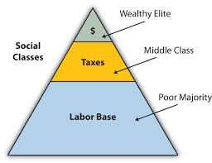
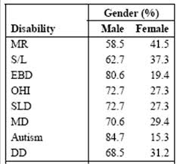
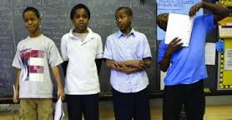
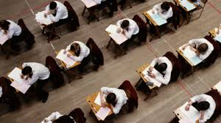
5. Schools are political sites
Whoever controls the schools, controls the future
Schools reproduce the social hierarchy
Learning how to read and write is a political act
Disability & Special Education are political, not educational ideas
Standardized Testing is a political, not an
educational concept

Slide 58
Literacy with an attitude: Powerful Literacy vs. Functional Literacy
Powerful literacy leads to positions of power and authority
How to read, write, and think critically
Functional literacy is the mere ability to meet the reading and writing demands of daily life
--While it makes a person productive and dependable, it assures that this person is not “troublesome”
Teaching literacy with an “attitude” means exposing the hidden curricula of schooling that maintain the status quo:
--Power and authority for some
--“Domestication” for the rest
Chester Finn Literacy with an Attitude: Educating Working-Class Children in Their Own Self-Interest (1999)

Slide 59
Media Literacy: Reading the word and the world
African American children and youth are easily susceptible to being manipulated by media
Media Literacy: ACCESS, ANALYZE, EVALUATE all media:
--sculpture --drawing/painting --dance --theater --books
--plays/film --poetry --Zoom --clothing --video games --TV
--architecture -- social media --print/media ads --political speeches
Media Literacy: the ability to CREATE and ACT using all forms of communication
All media shares one thing: someone created it, and they created it for a reason
Understanding that reason is the basis of media literacy
Reading the word and the world
Media Literacy empowers people to be critical thinkers and creators, effective communicators, and active citizens
Learning how to read world is civics education

Slide 60
Civic Literacy
Is America possible? -- Vincent Harding
What does s constitutional democratic republic require of its public schools?
Literacy and numeracy are each fundamental for participation in our community, but so is the knowledge and capacity of citizens to make sense of their democratic society. Since the democratic way of life is built upon opportunities to learn what it is about and practice how it might be led, civic literacy is the capacity of students to experience democracy inside and outside of their public school.
Civic literacy embodies the knowledge, skills, and decision-making activities students need to participate and initiate progress in their classroom, community, and the greater world.
It is the foundation by which a democratic society functions: citizen self-determination as a means to create avenues for peaceful change.
What can students do to help run their school?
“We must remove the contradictions in our culture that embrace democratic ends for its schools, but resists the actual practice in schools of the democratic means from which the ends cannot be separated. “ --The Institute for Democracy in Education
Research shows when students are involved in school-related decision-making, everything improves at school: student-student/student-adult relations, discipline, grades, and grad rates. There is no research showing when students are involved school climate gets worse. None!
http://vorcreatex.com/wp-content/uploads/2012/08/A-Civic-Literacy-What-does-a-constitutional-democratic-republic-require-of-its-schools.pdf

Slide 61
Standardized testing
“Consistent with notions of American identity, standardized testing, as an opposition to a cultural other, represents the normalization of whiteness, richness, and maleness.” -- Andrew Hartman
“Standardized tests have become the most effective racist weapons ever devised to objectively degrade Black minds and legally exclude their bodies.” -- Ibram X. Kendi
Testing of Learning: Standardized Tests; Political activity; Ranks and sorts students
Testing for Learning: Formative Assessment; Natural activity; Helps students learn for mistakes and successes
Testing Industrial Complex: Incarcerating education since 2001
https://www.academia.edu/19692164/The_Testing_Industrial_Complex_Incarcerating_Education_Since_2001

Slide 62
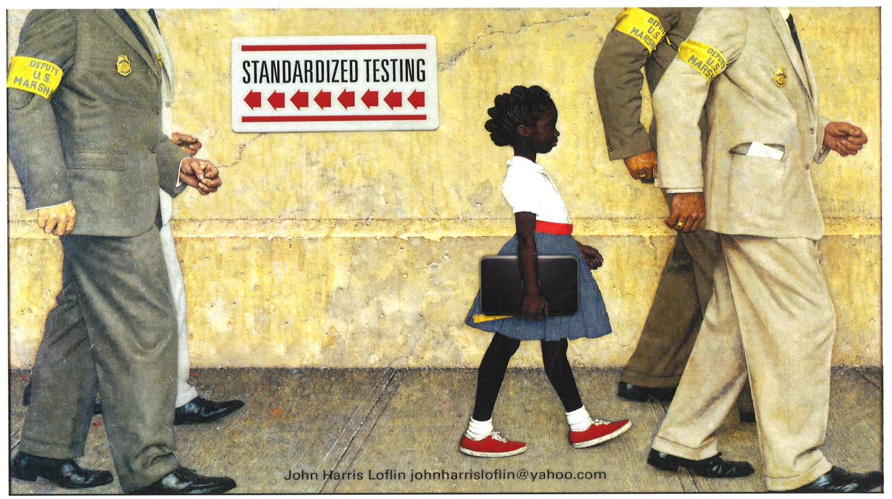
This picture is a parody of an iconic image from the U.S. Civil Rights Movement. The original, painted by Norman Rockwell in 1964, depicted Ruby Bridges on her way to an all-white public school in New Orleans in 1960. Because of threats of violence against her, she was escorted by four Deputy US Marshals who were protecting her right to attend an integrated public school. In this picture, the same Deputy US Marshals are resurrected in a post-modern version of Rockwell’s painting. This time they are escorting her from the school and protecting her family's constitutional right to opt her out of mandated standardized testing.

Slide 63
Standardized Testing: The Hoosier Connection
“Past and present: Eugenics, standardized tests, and politics of school reform: Hoosier connections and challenges” by John Harris Loflin, 2013
Ellwood P. Cubberley (1868-1941) was born in Antioch (later Andrews), IN
Lewis M. Terman (1877-1956) from Johnson County, IN
David Starr Jordan (1851-1931) Gainesville, NY. Taught at Butler and IU. Became president of IU and then Stanford (1891-1917) which renamed campus spaces named after him due to his eugenics past -- Oct. 7, 2009 https://news.stanford.edu/pr/2009/
http://vorcreatex.com/wp-content/uploads/2016/03/Past-present-Eugenics-standardized-tests-the-politics-of-school-reform-Hoosier-connections-challenges.pdf

Slide 64
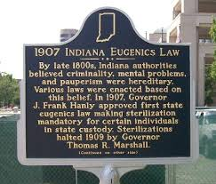
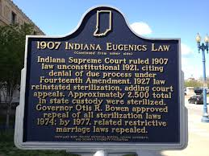
The Hoosier 1907 Eugenics Law to eliminate “the unfit”
The markers are located in the 100 block of North Senate Ave.

Slide 65
White Supremancy
“Until you understand white supremacy everything else will confuse you.”
-- Dr. Neeley Fuller

Slide 66
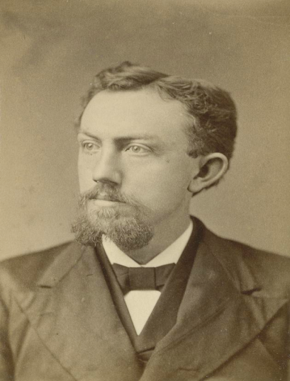
David Starr Jordan (1851-1931) Nationally recognized Eugenicists
1851: born in Gainesville, NY
1874-1875: taught science Indpls. Shortridge HS
1875-1879: taught biology Butler College
1879-1884: taught Natural History at IU
1884-1891: IU president
1891-1913: Stanford University founding president
While at Stanford, Dr. Jordan brought his prize Hoosier students:
Lewis Madison Terman (1877-1956) Johnson, Co., IN Father of Stanford-Binet IQ Test in 1917
Ellwood P. Cubberley (1868-1941), Andrews, IN. Father of “tracking” Dean of School of Ed. at Stanford (1917-1933) He created the “science” of school management and promoted testing to rank/sort students
Notes:
It is interesting that Dr. Jordan found a home at Butler for his Eugenics worldview. He became professor of natural history at Northwestern Christian College (later Butler University) in 1875. He received a medical degree in 1875 (Indiana Medical College)
https://biography.yourdictionary.com/david-starr-jordan and Honorary Ph.D. awarded by Butler in 1877. https://en.wikipedia.org/wiki/David_Starr_Jordan

Slide 67
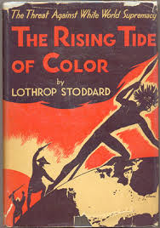
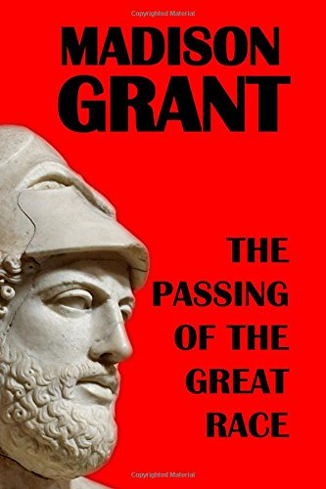
Eugenics Eliminating the inferior Saving the superior Francis Galton 1883 “scientific racism” “racial hygiene”
1916 1920

Slide 68
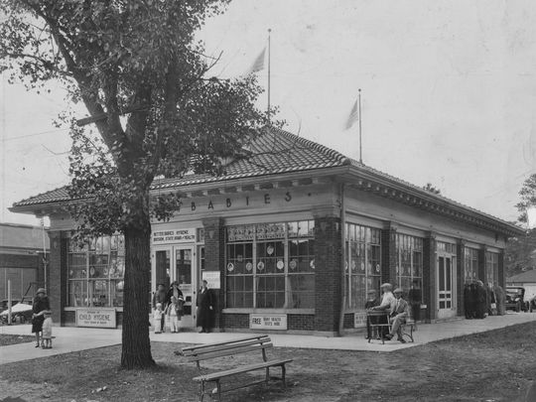
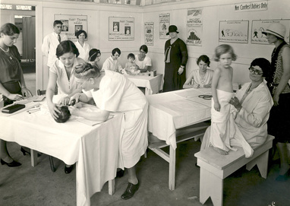
Indiana State Fair Baby Contests “Insuring that Hoosiers were breeding the healthiest and most desirable human beings”
1921-1932 Better Babies Bldg. constructed in 1927
Now the Hooks Drug Store Museum
Notes:
The Better Babies Bldg. constructed in 1927 on the Indiana State Fairgrounds is now the Hooks Drugstore Museum. http://hooksmuseum.org/ Remember, an all-Black Attucks HS also opened in 1927.

Slide 69
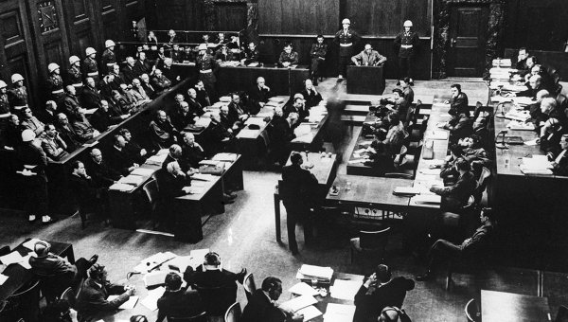
The Indiana Procedure
During the 1947 post -WW II Nuremberg Trials, when asked about their sterilization program, Nazi physicians referred to "the Indiana procedure."
http://www.newswithviews.com/NWO/newworld17.htm
Dennis L. Cuddy, PhD 04.29.02

Slide 70
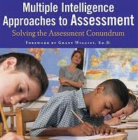
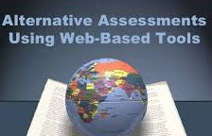
Multiple authentic and equitable assessments
“Cross the river in a crowd and the crocodile won’t eat you.”
Provide students a variety of ways to show what they know and can do
Is it professional malpractice not to provide assessment options?

Slide 71
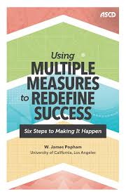
Multiple Measures: Redefining success
Giving students more than one way
to show what they know and can do

Slide 72
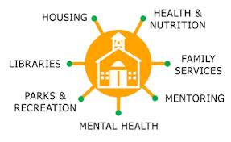
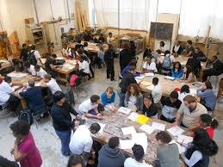
6. Our government schools have a public purpose, not a private purpose
According to Jefferson, the purpose of public education is to “nurture virtuous citizenship” and a viable democracy
Transformational Community Schools “Where neighbor- hoods practice self-determination”

Slide 73
Education for Citizenship
A CIVIC LITERACY
What does America’s constitutional democratic republic
require of its public schools?
Summary: Literacy and numeracy are each fundamental for participation in our community, but so
is the knowledge and capacity of citizens to make sense of their democratic society. Since the demo-
cratic way of life is built upon opportunities to learn what it is about and practice how it might be led, civic literacy is the capacity of students to experience democracy inside and outside of their public school. Civic literacy embodies the knowledge, skills, and decision-making activities students need to participate and initiate progress in their classroom, community, and the greater world. It is the foun-dation by which a democratic society functions: citizen self-determination as a means to create avenues for peaceful change. This is what our democracy requires of its schools.
We must remove the contradictions in our culture that embrace democratic ends for its schools,
but resists the actual practice in schools of the democratic means from which the ends cannot
be separated. -- The Institute for Democracy in Education
True democracy doesn’t use education to move the worker-citizen from unskilled to skilled. Instead,
it relies on education to position every citizen to govern. This project of democratic education can be carried out only by educators with the critical commitment to act on behalf of freedom and social justice that serve as a model for their students to discover their own personal power, social transfor-
mative potential, and most of all their spirit of hope. -- from the ideas of Antonia Darner (1997)
John Harris Loflin Democratic Education Consortium Indianapolis

Slide 74
Transformational Community Schools
Schools in a community run by the community
Providers/professionals from outside the community find a protégé who will eventually take their place.
This supports the self-determination and self-reliance of the community
http://vorcreatex.com/wp-content/uploads/2019/03/Transformational-Community-Schools.pdf

Slide 75
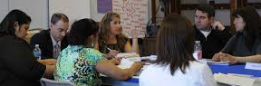
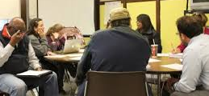
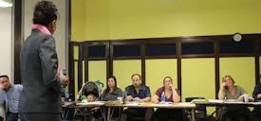
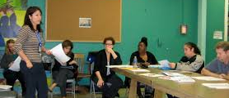
Parent Voices: Local School Councils
6 parents + 2 community members--elected every 2 yrs
2 teachers + 1 student (if high school)
1 school principal
Help develop, approve, monitor school’s improvement plan and budget
Hire/fire the principal

Slide 76
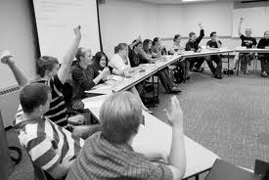
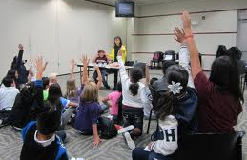
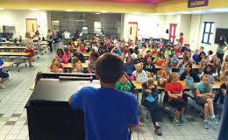
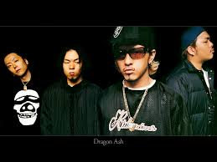
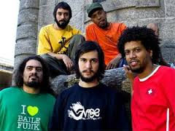
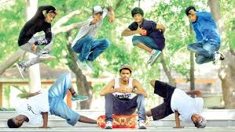
Student & Youth Voices
What can students do to help run their school?
Young people must be a part of creating the world they will inherit
View global hip hop youth culture as an asset, not a liability
Japan Brazil
Japan India
Japan Brazil
India

Slide 77
Student Voice
Democracy “Two wolves and a sheep deciding what to have for lunch.”
Native American saying:
“Whatever you do for me without me is against me.”
UK
School Councils https://www.schoolcouncils.org/
Australia
CONNECT Magazine https://research.acer.edu.au/connect/
United States
Meaningful Student Involvement in every aspect of the educational process
Adam Fletcher SoundOut.org https://soundout.org/
Classroom Meetings

Slide 78
First Amendment Schools: Where students practice the Five Freedoms in their schools
Now is the time to introduce the concept of First Amendment Schools
Students from across the state who are marching out in the streets and protesting police actions shootings are practicing their right to speak, assemble, and petition their government.
“Freedom and justice, however important, can never be enough; learning about democratic citizenship must be more than an academic exercise.”
~ First Amendment Schools, p. 21
Thus, these same students will be interested in continuing to practice the five freedoms, including freedom of the press and religion, in their classrooms and schools.
“Cui bono? Who benefits when Black American students do not attend 1st Amendment schools?”

Slide 79
Indianapolis Youth Bill of Rights
WHEREAS youth want to address the following issues:
--developing sustainable relationships and opinions with police;
--the right for students to be treated with respect and as equals;
--building healthy relationships based on honesty, trust, and communication;
--education on the opportunities and risks of social networking;
--respecting all cultures and addressing needs of all people;
--acquiring the skills, training, and access to help them become our nation’s future leaders;
--the right to make mistakes so youth can continue to learn and grow;
--the right to study curriculum that is relevant to their life experiences, which includes content acknowledging the struggle of oppressed people; and
--the right to learn about basic money management and a good quality of life.
-- http://stoptheviolenceindy.org/ Rev. Anthony Beverly

Slide 80
Youth Participatory Action Research (YPAR): Teaching youth how to conduct research to support their agenda
YPAR is a way to engage students in investigating an issue of concern that they see in their community. Once they’ve done their research, students then work on a plan and tackle that issue and make their neighborhood better.
Understanding power
https://www.youtube.com/watch?v=c_Eutci7ack
What Is YPAR and how does it relate to civics?
http://civiceducator.org/what-is-youth-participatory-action-research-ypar/
YPAR: A Tool to Address School Climate Issues
https://www.youtube.com/watch?v=SricMtRlBdk
YPAR Tool Kit
https://youthprise.org/ypar-toolkit/#:~:text=Youth%20Participatory%20Action%20Research%20(YPAR,%2C%20cultural%2C%20and%20political%20transformation

Slide 81
Community Organizing: Empowering students
What is community organizing? https://www.youtube.com/watch?v=NElvLp4Oyr0
Community organizing represents the actual practice of democracy
It is imperative that young African Americans get trained in and become practitioners of community organizing.
Community organizing is the process of:
--building power through involving a constituency in identifying problems they share and the solutions to those problems that they desire
--identifying the people and structures that can make those solutions possible
--enlisting those targets in the effort through negotiation and using confrontation and pressure when needed
--building an institution that is democratically controlled by that constituency who can develop the capacity to take on further problems which embody the will and the power of that constituency
Community organizing for racial equity and policy making
Most efforts to address any aspect of racism, privilege, power or oppression begin with or eventually end up including some form of community organizing.
Since change mainly comes from the policy level, preparing youth to use community organizing as a means to affect institutional, educational, and governmental policy makes sense. http://ai.stanford.edu/~ruzon/PIA/pico_process.html

Slide 82
“Keepin’ it real, Keepin’ it right” Validate the promise of hip hop
A worldview of those born after 1965
- Authenticity - Social Justice
Hip hop models for youth the authenticity they seek.
Hip hop is about “Keepin’ it real” vs. “busters” “posers” “wanna be’s”
“This is a message to the oppressor, not in hope that he will listen, but with the expectation that my own existence will be clarified.”
~ James Cone, Black Theology 6-Black Power
“Keepin’ it real” and self-actualization share the
same DNA

Slide 83
Hip hop: Global youth culture
Education as a political act:
Understanding how to engage Black students who identify with hip hop culture
http://vorcreatex.com/wp-content/uploads/2021/02/Education-as-a-political-act-Understanding-how-to-engage-Black-students-who-identify-with-global-youth-hip-hop-culture-.doc.pdf
“The cultural disconnect between [public schools] and hip-hop…is perhaps the single most important challenge in reaching Black youth who are simply not motivated, interested, or inspired by...efforts in which their urban identities are not represented.
-- S.Ginwright, Black in school: Afrocentric reform, urban youth, and the promise of hip hop
Hip hop is more than a global youth culture, or music and fashion;
it’s a political stance.
It is this critical stance--built into global hip hop that most local Black children and youth share— which requires a regard for the political aspects of education. Indiana residents and school districts that deny or ignore “the political” can further alienate those youth who are the more at-risk of crime and violence. Districts will only reach them if their education is seen and fostered as a political act.

Slide 84
Rites of passage: From child to adult-citizen
Youth must show they’re no longer children
Society must provide youth rites of passage or
youth will create their own

Slide 85
Rites of Passage
“Adolescence is not for everybody.” -- John Harris Loflin
Reinvent adolescence
http://vorcreatex.com/wp-content/uploads/2012/06/A-Proposal-to-Reinvent-Adolescence-and-Create-a-Community-Youth-Charter.pdf
Rites of Passage
Youth must show they are no longer children.
If society does not provide authentic Rites of Passage, youth will find their own ways
Gangs and radicalized groups provide this
http://vorcreatex.com/wp-content/uploads/2012/06/Transform-Rites-of-Passage-Combine-the-Walkabout-model-and-accelerated-learning-concept-1.pdf
Rites of passage and citizenship
Mixing adulthood and citizenship
Gaining adult and citizen status at the same time
http://vorcreatex.com/wp-content/uploads/2012/06/Reinvent-adolescence-Combine-rites-of-passage-and-citizenship-education.pdf

Slide 86
Teacher Voices
If teachers are to win the hearts and minds of urban students and their families, they must take 3 actions:
a) Teach for social justice
b) Organize their peers to do the same
c) Live around the school where they teach

Slide 87
The Political Clarity of Dr. Lisa Delpit
Delpit asks: “Is it okay to discuss politics in class?”
She speaks to our contentious world and the necessary conversations teachers must have about it with students.
Delpit inspires teachers to support their students in navigating the current events, cultural shifts, and social dilemmas that shape their communities and country.
https://www.amazon.com/Teaching-When-World-Fire-Delpit/dp/1620974312

Slide 88
Use pedagogies of liberation
Critical Pedagogy: students become critical thinkers and problem solvers
Pedagogy of Recognition: recognizes and validates a student’s personhood, family, culture, neighborhood; and, recognizes the social toxins such as poverty they face daily
Culturally Sustaining Pedagogy: sustains linguistic, literate, and cultural pluralism as part of the democratic project of schooling
THUG LIFE Pedagogy: a way of teaching based on the life and poetry of Tupac Shakur

Slide 89
Pedagogy
Critical Pedagogy
Students view certain aspects of their lifestyles, society, nation, or culture critically
Qui bono? “Who benefits?” “Follow the money” “Whose interests are being served here?”
Reject the idea that knowledge is politically neutral
Argue that teaching is an inherently political act and schools are political sites
Deconstruct Unpack Dismantle

Slide 90
Pedagogy
Culturally Sustaining Pedagogy
Raises fundamental questions about the purpose of schooling in changing societies.
Teaching that perpetuates and fosters linguistic, literate, and cultural pluralism as part of schooling for positive social transformation
Schooling should be a site for sustaining the cultural practices of marginalized communities—not eradicating them.

Slide 91
Pedagogy
THUG LIFE Pedagogy based in Tupac’s
“The Hate You Give Little Infants Fucks Everybody”
A way of teaching the more alienated youth by validating their critical stance toward schooling and society
THUG
A term used with pride to describe someone who started out with nothing and built themselves up to be something
A determined and resilient attitude to succeed in life in spite of a criminal background, systemic racism and socio-economic injustice
Movie THE HATE U GIVE

Slide 92
THE HATE U GIVE
Starr Carter is 16 and lives in the fictional Black neighborhood of Garden Heights, but attends the majority white Williamson Prep school.
This would be a perfect scenario for her, but Starr has a problem: she has to fit into the white culture at Williamson where she code switches while having to “keep it real” when returning to “the Heights.”
The Hate U Give, Official Trailer https://www.youtube.com/watch?v=3MM8OkVT0hw
The Hate U Give https://www.nytimes.com/2018/10/18/movies/the-hate-u-give-expletive.html
Here’s dilemma: the more she conforms (acts white) the more she loses a sense of self and feel alienated. By resisting the majority culture in an effort to preserve her “Blackness,” she’s exposed to “disproportionate prejudices and disciplinary consequences.”
Teaching Guide, The Hate U Give
https://b0f646cfbd7462424f7a-f9758a43fb7c33cc8adda0fd36101899.ssl.cf2.rackcdn.com/teaching-guides/TG-9780062498533.pdf
What some urban students resist/reject is not “acting white,” but the assumption that to succeed in school one must assimilate into white middle-class society to the exclusion of one's own culture.
So, as Dr. Prudence Carter notes in Keepin’ it real, it’s not that Starr had to act white to be successful, she couldn’t act Black and be successful.
Q&A with The Hate U Give author Angie Thomas https://www.youtube.com/watch?v=xQJtCTtoA9g
See more at John Harris Loflin’s : Resisters, Rejectors, and Ridas: How to make urban schools work for disengaged students and critically conscious teachers

Slide 93
A Pedagogy of Recognition
Education where educators name, know, respect, and celebrate students…
--not just recognizing their presence, but their age, social class, gender, back-ground, daily experiences, family, peers, youth culture, neighborhood and its problems
This is full validation: here the student can’t say, “No one cares about me.”

Slide 94
Why recognition is important
“No more fiendish punishment could be devised, were such a thing physically possible, than that one should be turned loose in society and remain absolutely unnoticed by all the members thereof.
If no one turned around when we entered, answered when we spoke, or minded what we did, but if every person we met “cut us dead,” and acted as if we were non-existent things, a kind of rage and impotent despair would before long well up in us, from which the cruelest bodily torture would be a relief.”
-- William James

Slide 95
Pedagogy of recognition
Curricular In what ways does the curriculum reflect the lived realties of the youth I serve?
Contextual In what ways does the social context help me understand the lives and schooling experiences of the students I serve?
Teaching In what ways does power influence the learning and relational environment of the classroom?
Transformative In what ways do all aspects of the educational endeavor live up to principles of justice, transformation, and freedom?
http://vorcreatex.com/wp-content/uploads/2016/03/Validating-the-experiences-of-urban-students-A-Pedagogy-of-Recognition.pdf

Slide 96
Career & Interest Survey
Name __________________
ACCOUNTANT ___
ADJUSTER (INSURANCE) __
ADVERTISING __
AEROBICS INSTRUCTOR _­_
AGRICULTURE __
AIRPLANES__
PILOT __
MECHANIC __
DESIGNER__
AMUSEMENTS__
ANESTHETICS__
ANIMATION__
ANTIQUES __
APPAREL/CLOTHES__
APPLIANCES __
APPRAISER __
ARCHEOLOGIST __
ARCHITECT __
AROMATHERAPITS__
ARTIST __
ASTROLOGER __
ATHLETICS __
AUDIOLOGIST __
AUTOMOBILES __
DRIVER __
MECHANIC __
DESIGNER __
BODY REPAIR__
AUTO SUPPLIES __
AVIATION __
BAKER __
COOK __

Slide 97
Issues Survey
Name__________________________
__The Abortion Controversy
__Abortion
__Addiction
__Adoption
__Africa
__An Aging Population
__AIDS
__Alcohol
__Alcoholism
__America Beyond 2001
__American Foreign Policy
__American Values
__America's Defense
__America's Prisons
__America's Victims
__Assisted Suicide
__Biomedical Ethics
__The Breakup of the Soviet Union
__Cancer
__Capital Punishment
__Censorship
__Central America
__Chemical Dependency
__Child Abuse—Physical, Sexual,
Psychological
__Child Welfare
__Civil Liberties
__Computers and Society
__Conserving the Environment
__Constructing a Life Philosophy
__Crime
__Crime and Criminals
__Criminal Justice
__Cults
__Culture Wars
__Death & Dying
__The Death Penalty
__Depression
__The Disabled
__Discrimination
__Drug Abuse
__Eastern Europe
__Eating Disorders
Other issues not profiled
__Affirmative Action
__Alternative Schools, Charter Schools,
Vouchers
__Anti-Semitism
__Business Ethics
__Child Labor and Sweatshops
__China
__Cloning
__Date Rape
__Does Capital Punishment Deter
Crime?
__Domestic Violence
__Drug Trafficking
__Environmental Justice
__Food Safety
__The Future of the Internet
__High School Dropouts
__High Stakes Tests
__The Hip Hop Culture
__The Media and Politics
__Peer Pressure
__Rites of Passage
__Rise in World Democracies
__Sexually Transmitted Diseases (STD)
__Single-Parent Families
__Student Rights
__Teen Employment
__The United Nations

Slide 98
The importance of “being seen” Why recognition is so necessary
Ubuntu greeting: “I see you.” “Here I am.”
We exist because we are seen, because the people around us recognize us
Acknowledging (seeing) and validating (respecting) students is fundamental to teacher-student relationships
The invisible child
The invisible youth
The Invisible Man by Ralph Ellison
Self-affirmation
Not just survival, but living with esteem and dignity
A sense of significance and fulfillment that’s also
-- validated --regarded --respected
The need for recognition becomes the central issue in self-affirmation

Slide 99
Validate students through US history
Turner Fair Charts African perspective
on history of Africa & North America

Slide 100
The Historic Journey resource curriculum is a comprehensive K-12 interdisciplinary curriculum that is aligned to Indiana State Standards. The curriculum, both text and web based, explores the literary, historical, social, scientific, mathematic and cultural endeavors of African and African-Americans.

Slide 101
Emotional Intelligence
Consists of four attributes:
Intra Personnel
Self-Knowledge – You recognize your own emotions and
how they affect your thoughts and behavior, know your
strengths and weaknesses, and have self confidence.
The question, “Who am I ”
2) Self-management – Self-discipline You’re able to control
impulsive feelings and behaviors, manage your emotions
in healthy ways, take initiative, follow through on
commitments, and adapt to changing circumstances.
Inter Personnel
3) Social awareness – You can understand the emotions,
needs, and concerns of other people, pick up on emotional
cues, feel comfortable socially, and recognize the
power dynamics in a group or organization.
4) Relationship management – You know how to develop and maintain good relationships, communicate clearly, inspire and influence others, work well in a team, and manage conflict.

Slide 102
Vigor not rigor
Vigor is more culturally appropriate for African American students
Compare Rigor vs. Vigor to Augusta Mann’s “Nine Recurring African American Cultural Themes”
--Spirituality
--Resilience
--Humanism
--Communalism
--Orality/Verbal Expressiveness
--Realness
--Personal Style/Uniqueness
--Emotional Vitality
--Musicality/Rhythm

Slide 103
Contrasting the relevance of academic rigor vs. vigor to Augusta Mann’s 9 African American cultural themes | Rigor | Vigor
Spirituality pervades the traditional African and African American ethos. It’s based on the belief that all elements in the universe are of one substance (Spirit) & that all matter, animate or inanimate are merely different manifestations of the God force (Spirit) | No “Spirituality” is academically inappropriate; it’s not rational | Yes Spirituality gives learning its aliveness & purpose
Resilience is the conscious need to bounce back from disappointment & disaster and to have the tools of humor & joy to renew life's energy. Resilience is related to verve. Verve is desire for creative extemporaneousness-a sense of utter antipathy for the mundane and monotonous, the ability to focus on & handle several issues at once. The idea of transformation (the process of becoming better) is informed by two distinct yet interrelated ideas, verve & resilience. | No “Verve” is academically inappropriate: it’s too close to emotions & not logical or linear enough | Yes It is verve that drives inquiry/learning; Verve gives rigor the “life” it needs to be real & authentic
Humanism describes the African view of the whole world as vitalistic (alive) & this vitalism is grounded in a sense of goodness. | No Humanism is not grounded in science | Yes Essence of vigor is vitality & aliveness
Communalism denotes awareness of the interdependence of people. One acts in accordance & the notion that the duty to one's family & social group is more important than individual privileges & rights. | No Purpose of rigor not chiefly communal | Yes Informs community sustainability
Orality/Verbal Expressiveness refers to the special importance attached to knowledge passed on through word of mouth & the cultivation of oral virtuosity. | No Orality is not as academic as writing | Yes Adds to, not subtracts from, academics
Realness refers to the need to face life the way it is without pretense. It’s manifested by frankness of manner, casualness in social transactions, contempt for artificiality & falseness in human conduct, & an aversion to formality & standardization. | No Seen as having little to do with academics & studying | Yes Gives sub- stance/ authen- ticity to purpose of academics
Personal Style/Uniqueness refers to the cultivation of a unique or distinctive personality or essence & putting one's own brand on an activity. It implies approaching life as if it were an artistic endeavor. | No Seen as having little to do with academics & studying | Yes Drives the depth/breadth of both rigor & vigor
Emotional Vitality expresses a sense of aliveness, animation, & openness conveyed in language, oral literature, song, dance, body language, folk poetry, & expressive thought. | No Seen as having little to do with academics & studying | Yes Matches perfectly with essences of vigor
Musicality/Rhythm demonstrates the connectedness of movement, music, dance, percussiveness, & rhythm, personified through the musical beat. Also implied is a rhythmic orientation toward life. Rhythm, the fundamental principle of human behavior, reigns as the basic ingredient of African American expressiveness. | No Musicality/ rhythm seen as having little to do with academics & /studying | Yes Musicality/ rhythm adds to spirit/climate of academic study in classroom

Slide 104
Discipline
“Discipline is a bad word in our culture. People associate it with rewards or punishments, having to do what they're told. But discipline is quite a lovely word. It comes from the same root as disciple, and it means seeing yourself through the eyes of the teacher who loves you, who sees your promise. It’s a loving response to a teacher to do what it takes to reach that potential. The onus is on the adult to be such as to inspire the student to be a disciple.”
-- Marian Woodman https://www.powerquotations.com/quote/discipline-is-a-bad-word

Slide 105
Re-examining resistance as oppositional behavior
We can’t be against all resistance by Black students to school: We have to be for opposition that’s transformational
Research shows Blacks as disadvantaged by branding getting good grades as “acting white.” This label leads students to resist/oppose schooling. But, are we to view all oppositional behavior as “bad” or can it actually be transformative?
Prof. A.A. Akom notes Black urban students will adopt a mainstream studious orientation to school if the orientation is developed through a Black achievement ideology based on critical thinking.
Akom reveals how the academic lives of Black students are influenced by a schooling ethos rooted in racial and class distinctions and thus how the concept of “oppositionality” often originates in and is nurtured by schools themselves.
Akom does not suggest special treatment--supporting the idea that Black students can be academically successful without being conformists and without rejecting their race-ethnicity.
http://docplayer.net/8777780-Reexamining-resistance-as-oppositional-behavior-the-nationof-islam-and-the-creation-of-a-black-achievement-ideology-a-a-akom.htm

Slide 106
Education for liberation: Why would students act up in a school that’s trying to liberate them?
“Education is never neutral, it either colonizes or liberates. Education either functions as an instrument which is used to facilitate integration of the younger generation into the logic of the present system and bring about conformity or it becomes the practice of freedom, the means by which [we] deal critically and creatively with reality and discover how to participate in the transformation of their world.” -- Paulo Friere
The concept of “Education for liberation--Education as the practice of freedom” exposes the colonial-political purposes of traditional education and the neocolonial-political function of charters, both of which can reproduce social inequities and validate normalcy.
The level of conformity required by school success gives unfair advantage to the mainstream and those cultural and racial minorities who are bamboozled into a subservient assimilation.
For those not confusing domestication, indoctrination, or colonialism with education, why would they be discipline problems in a school that’s trying to liberate them?
https://www.researchgate.net/publication/317098285_What_is_a_high_quality_education_for_urban_students_Education_for_Liberation_Education_as_the_practice_of_freedom
Starting July, 2017, “What is a quality education for urban students?” currently has 482 reads from 41 different countries including the US Review: http://vorcreatex.com/wp-content/uploads/2021/02/Global-Readings-Chart-What-is-a-quality-education-for-urban-students-Education-for-liberation-Education-as-the-practice-of-freedom.pdf

Slide 107
Advancing the PBIS Concept Democracy and school/classroom discipline: Moving from behavioral models to cognitive model Moral development not behavior modification: The influence of democracy on school discipline The challenge to educators is to not control students through external reward…, but to create that democratic [school]society in which individuals make choices for the common good of whole group. -- ”Building a Democratic Learning Community” Colville-Hall, 2000 Empowering Positive Behavioral Interventions and Support Advancing students from outer directed to inner directed persons: Moving the locus of control from the school to within the student
Current PBIS characteristics
--respect
--responsibility/reliability
--tolerance
--caring
--fairness
Advanced PBIS characteristics
--self-determination
--sustainability
--social-economic justice
--democracy
--equity

Slide 108
De-colonize the Achievement Gap
Marva Collins already proved Black children are teachable and able to overcome obstacles of learning via her teaching methods, which she said eliminated behavioral issues and allowed students to flourish.
“To believe in the existence of any sort of achievement gap, some sort of racial hierarchy is actually to believe in a racist idea. The achievement gap between the races with whites and Asians at the top and blacks and Latinos at the bottom is a racist hierarchy. And this popular racist hierarchy has been constructed by our religious faith in standardized testing.” -- Ibram X. Kendi
Is the Achievement Gap a political concept to justify the resulting ranking and sorting of standardized tests? Please realize that even when Black American students do well and close the gap, it’s in terms Euro-centric features around culture, values and epistemologies. The tragedy is that this achievement comes at the expense of Black culture, values, and ways of knowing--and with the insinuation of the inferiority inherent in these features

Slide 109
What has economics got to do with it? The impact of socioeconomic factors on mental health and the case for collective action
A clear link exists between social and economic inequality and poor mental health.
Income inequality is linked to higher prevalence of mental illness.
Psychiatric and psychological perspectives have dominated mental health research and policy, obscuring root socioeconomic contributors.
Create economic frameworks that move beyond an exclusive focus on economic growth to embrace collective and societal wellbeing. -- Macintyre, et al 2018
https://www.researchgate.net/publication/322799614_What_has_economics_got_to_do_with_it_The_impact_of_socioeconomic_factors_on_mental_health_and_the_case_for_collective_action

Slide 110
Neo-liberalism
Yes, like Gandhi, US Pres. Franklin Roosevelt and Martin Luther King who wanted people’s needs met, neo-liberals also want the these needs met, but they want the private/business sector to do it, not the government
“There is no society, only individuals.”
--Margaret Thatcher, former British prime minister
The African Ubuntu philosophy of “I am because we are” is the opposite of the neo-liberal Euro-centric emphasis on the individual
--Everything’s a commodity: try to make money off of everything
--The “market” (profit /loss) is used to understand/judge everything
--Free-market policies over social-democratic reform: turn voters into shoppers
--Deregulation: free trade/free market, roll back pollution laws
--Individual responsibility: no systemic/structural causes
--Privatization: parking meters, jails, schools
--Selling public assists to private concerns: IPS selling off schools
--Anti-union: African American workers have a long history of being pro-union
--”Gig” economy: no benefits, Uber drivers
--Out-sourcing: Kelly “temp” Services
The neo-liberal turn in Black politics Lester Spence
https://www.youtube.com/watch?v=k5prifYxTsE&t=23s

Slide 111
Education Cities
Education City” is a city where citizens choose to position education at the head of their priorities. In such a city, education is not what happens during certain hours and in certain places, it is the essence of the city itself. The vision of a “culture of learning” is driven by the belief that individual development and self-fullfilment through education improves the general quality of life for everyone
Pluralistic learning We are all different with our own strengths and weaknesses
Excellent Centers Where we continue to discover and uniqueness, find mentors, work with others and actualize our potential
Democratic Education and Education Cities
https://www.youtube.com/watch?v=YVethJuT9JU
http://www.educareallaliberta.org/israel-education-cities-network/

Slide 112
We can’t have social change without art
Plays, paintings, poetry, dance etc. have been a part of social change. Educators, especially through making the whole Black child media literate, can introduce the value of the arts in providing ways to foster social justice.

Slide 115
John Harris Loflin john@bl-pi.org www.vorcreatex.com

